Slide 1
20251002 F45 Run C05 unload transfer 破片

Slide 2
Discipline 1. 選定團隊 Form the Team
團隊負責人Team Leader/Dept.:
成員Team Member/Dept.:
Name | Department | Position
S210 邱敏知 | Diffusion Engineering Process Section | ENGINEER
S220 蔡孟哲 | Diffusion Engineering Equipment Section | TECHNOLOGY ASSISTANT MANAGER
S220 黃建華 | Diffusion Engineering Equipment Section | PRINCIPAL ENGINEER
S220 林韋志 | Diffusion Engineering Equipment Section | PRINCIPAL ENGINEER
S220 歐陽以橫 | Diffusion Engineering Equipment Section | SENIOR ENGINEER

Slide 3
Discipline 2.描述問題及現況掌握Describe the Problem
(WHO detected the problem? WHAT is wrong? State the problem in terms of object and defect. WHERE the problem was first detected, describe location of the detection, lot #, WHEN and HOW it was detected)
What | Run C05 unload C1 wafer to cassette, ENCODER MISMATCH 19 WAFR_RT—ROTATE Robot 撞擊 C4 stage cassette, 導致 C4 slot1~15 wafer broken
Where | F45
When | 2025/10/02
Extent | Total impact: 5lot/103pcs, scrap:15pcs C4 #11~25 wafer broken, other PTC impact OM check other stage by PTC impact
空

Slide 4
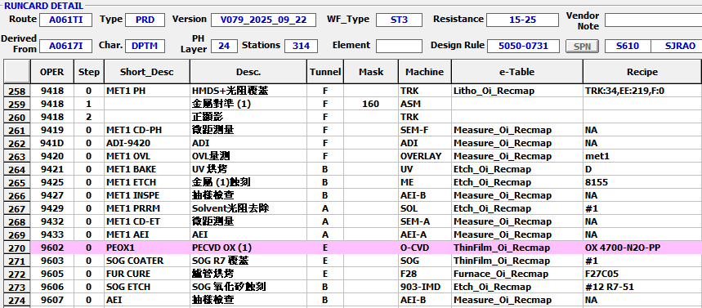
Run cards at impact station
A061TI, G061DI, G0414I, A0412I

Slide 5
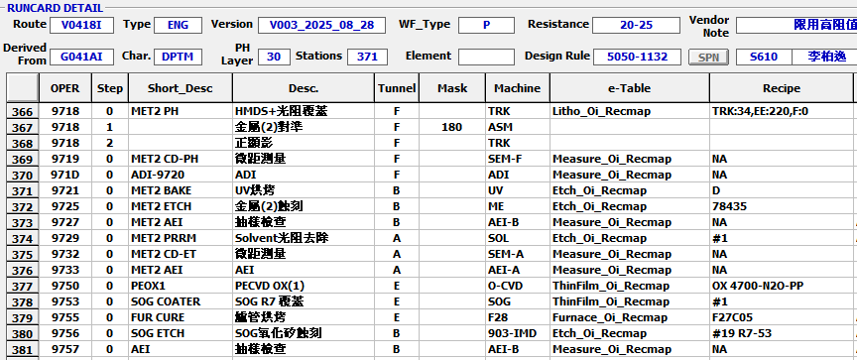
Run cards at impact station
V0418I

Slide 6
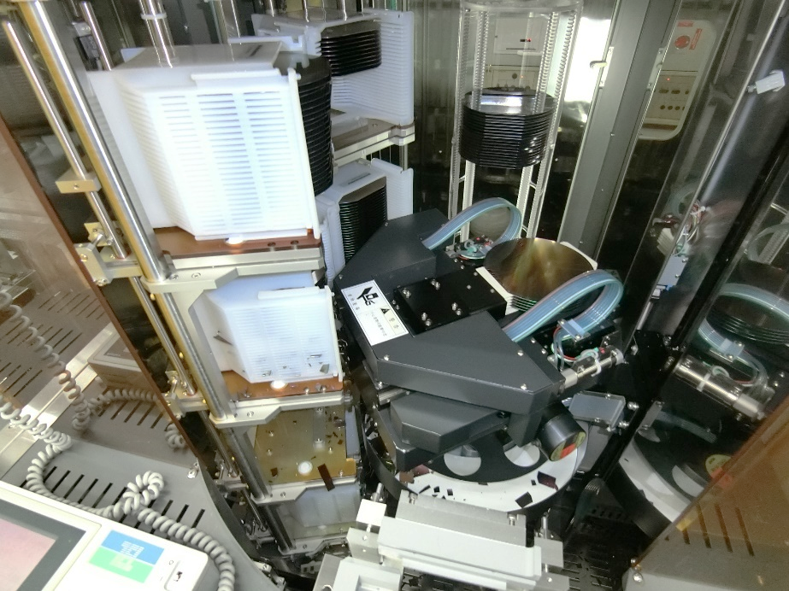
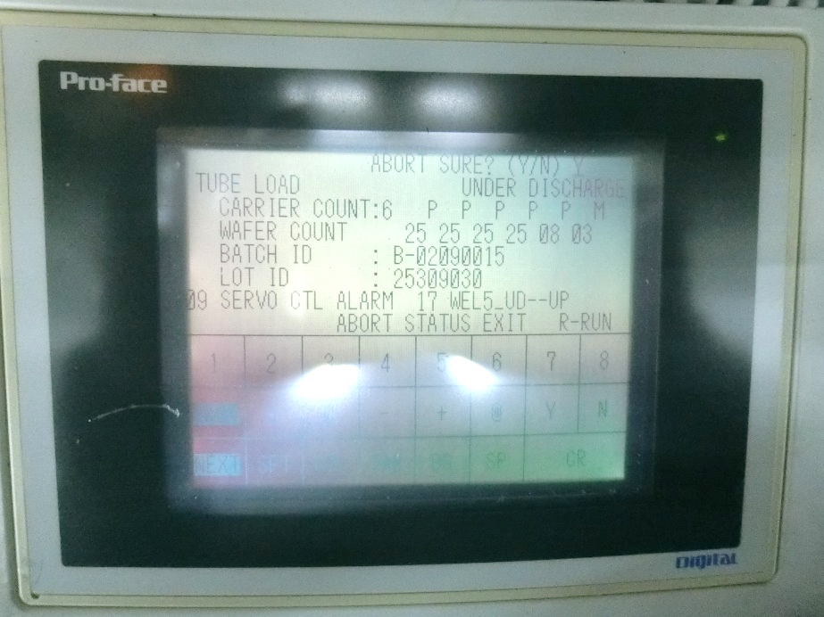
Discipline 2.描述問題及現況掌握Describe the Problem
(WHO detected the problem? WHAT is wrong? State the problem in terms of object and defect. WHERE the problem was first detected, describe location of the detection, lot #, WHEN and HOW it was detected)
​Run C05 unload C1 slot 11~15 (倒數第三抓)
Robot assembly 轉錯邊撞破 C4 slot 01~15
Check T-BAWL mapping 正常，alarm code servo control alarm 17 WEL5 UD
正常：逆時針轉
異常：順時針轉
Robot 轉錯邊撞擊 C4 cassette 內 wafer
當下 alarm 及 mapping

Slide 7

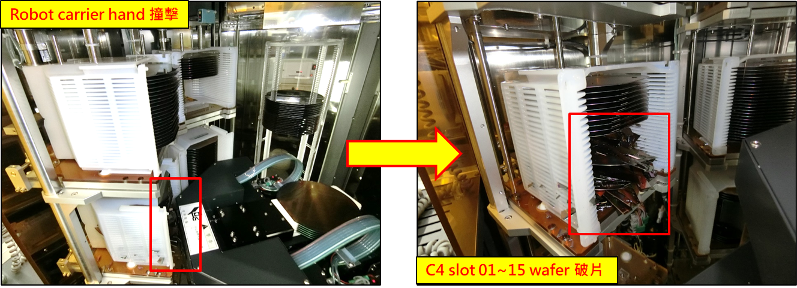
Discipline 2.描述問題及現況掌握Describe the Problem
(WHO detected the problem? WHAT is wrong? State the problem in terms of object and defect. WHERE the problem was first detected, describe location of the detection, lot #, WHEN and HOW it was detected)
確認 RMS log，當機前無發生其餘 alarm

Slide 8
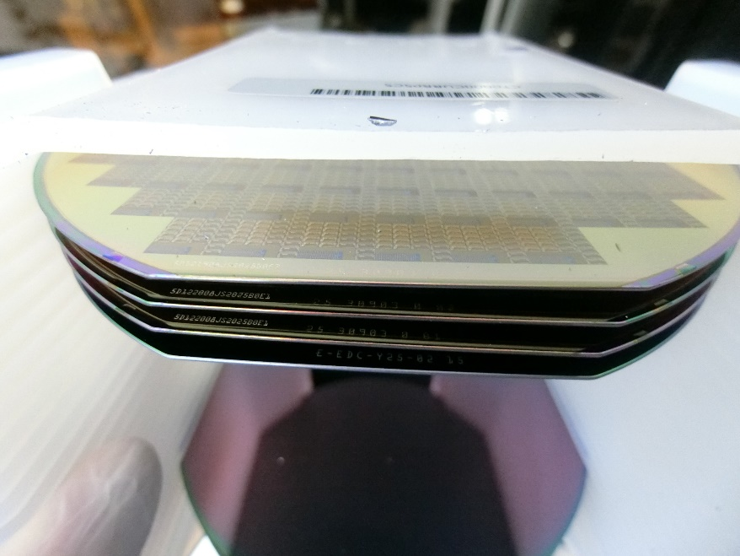
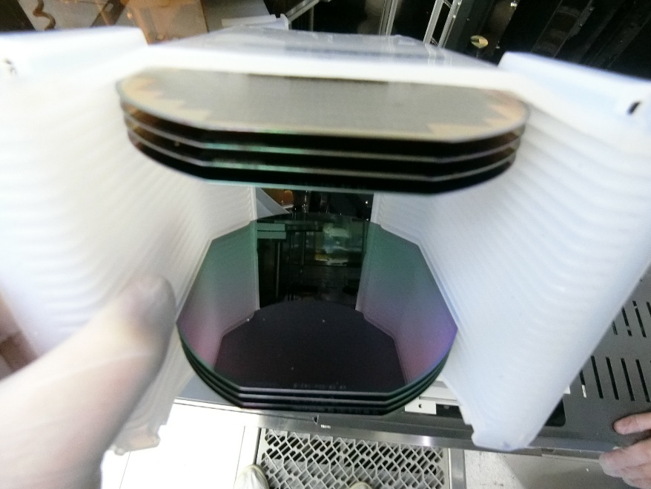
Discipline 2.描述問題及現況掌握Describe the Problem
(WHO detected the problem? WHAT is wrong? State the problem in terms of object and defect. WHERE the problem was first detected, describe location of the detection, lot #, WHEN and HOW it was detected)
C4-25102550 #11~25 broken on C4 stage
OM check C4 lot by PTC impact
Check C1/C2/C3/C5 by PTC impact

Slide 9
Discipline 2.描述問題及現況掌握Describe the Problem
(WHO detected the problem? WHAT is wrong? State the problem in terms of object and defect. WHERE the problem was first detected, describe location of the detection, lot #, WHEN and HOW it was detected)
Is/Is Not Analysis table (釐清問題):
 |  | Is | Is Not | Difference/Conclusion
What | object | Product wafer | M/W | Wafer 不同
 | Defect | wafer broken | wafer no broken | Robot rotate 異常撞擊 cassette內wafer
Where | Location | B-Tunnel | E-Tunnel | FAB-Tunnel 不同
 | Machine | F45 | F44 | 機台不同
When | First time | 2025/10/2 | Before 2025/5/15 | 時間不同
How | Many | 15 pcs | other | Wafer 有無遭受碰撞

Slide 10
Discipline 3.執行及驗證暫時防堵對策 Contain the Problem
(Define and implement containment actions to isolate the effect of problem from any internal/external customer until corrective action is implemented)
產品：
OM check wafer by PTC impact
All do scrubber clean then SOG-REBAKING
After SOG-REBAKING C1~C5 to AOI 5X check
Check AOI def%<5%, pass
Total impact:15pcs (25102550 #11~25 broken)
上貨時間 | 機台 | 程式 | LOC | Lot | Product | Route | Oper | Qty | AOI | Def count | Note
2025/10/2 08:56 | F45 | F45C05 | 1 | 25361390 | RC5D66 A | A061TI | 9605 | 25 | 0.7~1.32% | 46~98 | Pass
2025/10/2 08:56 | F45 | F45C05 | 2 | 25361830 | RA5E01 B | G061DI | 9605 | 25 | 1.01~2.09% | 54~152 | Pass
2025/10/2 08:56 | F45 | F45C05 | 3 | 25102570 | Y5Y08Y W | G0414I | 9605 | 25 | 0.56~1.09% | 198~466 | Pass
2025/10/2 08:56 | F45 | F45C05 | 4 | 25102550 | Y5Y08Y J | A0412I | 9605 | 25 | 0.78~3.16% | 318~823 Under defect | #11~25 broken scrap Other pass
2025/10/2 08:56 | F45 | F45C05 | 5 | 25309030 | Y47K4Y A | V0418I | 9755 | 3 | No data | No data | Mulit chip, pass

Slide 11
Discipline 3.執行及驗證暫時防堵對策 Contain the Problem
(Define and implement containment actions to isolate the effect of problem from any internal/external customer until corrective action is implemented)
3.1 異常產品 (Defect Lots)
項目 Item | 處理方式 Action | 負責人員 Resp | 預定完成日 Due | 實際完成日 Imp. | 處理結果 Verification
25102550 #11~25 | 破片 Scrap | 李治中 | 2025/10/2 | 2025/10/2 | #11~25 wafer broken scrap Other do SCR clean AOI check Check def%:0.78~3.16%, pass
3.2 波及產品 (Impact Lots)
項目 Item | 處理方式 Action | 負責人員 Resp | 預定完成日 Due | 實際完成日 Imp. | 處理結果 Verification
NA | NA | NA | NA | NA | NA

Slide 12
Discipline 3.執行及驗證暫時防堵對策 Contain the Problem
(Define and implement containment actions to isolate the effect of problem from any internal/external customer until corrective action is implemented)
3.3 波及設備 (Impact Machine)
項目 Item | 處理方式 Action | 負責人員 Resp | 預定完成日 Due | 實際完成日 Imp. | 處理結果 Verification
Robot CP3 排線 | Replace Robot CP3 排線 | 黃建華 | 2025/10/02 | 2025/10/02 | Check transfer & test run ok
3.4 波及製程 (Impact Route) : 是(YES)/否(No)
項目 Item | 處理方式 Action | 負責人員 Resp | 預定完成日 Due | 實際完成日 Imp. | 處理結果 Verification
NA | NA | NA | NA | NA | NA
3.5 產品召回選項，是否需進行客戶端波及產品的召回?是(YES)/否(No)
Customer | Product No. | Lot number / Wafer number | Approx. Quantity
NA | NA | NA | NA

Slide 13
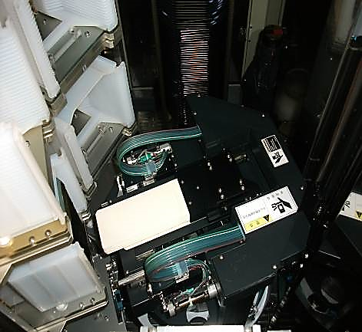

Discipline 4.定義及驗證真因 (Identify the Root Cause)
(Identify all potential causes which could explain why the problem occurred)
4.1 Non-conformance root cause (defect nature / technical root cause):
a) Failure mechanism:
Wafer unload 傳送方式: Cassette stage 在 Forward 位置
Fork 朝向 Boat 進去抓取 wafer (由下往上抓) → Robot 逆時針旋轉 → Fork 朝向 cassette stage 位置
→ Fork 進 cassette 放下wafer(由上往下放)，依序 Unload Boat wafer 至 C6~C1
F45 unload wafer Robot Fork 從 Boat 抓片放置 Cassette上，C5→C4→C3→C2→ unload C1 wafer 時
Robot 旋轉異常(逆時針轉變成順時針轉)，Robot assembly 撞擊 C4 Cassette 內 wafer 造成破片
正常：Robot 逆時針轉
異常：Robot 順時針轉
Backward
Forward
Robot 轉錯邊撞擊 C4 cassette 內 wafer

Slide 14
Discipline 4.定義及驗證真因 (Identify the Root Cause)
(Identify all potential causes which could explain why the problem occurred)
4.1 Non-conformance root cause (defect nature / technical root cause):
b) 列出所有可能的原因 (Probable Causes/Factors): Non-conformance
工具 (Tools): 故障樹分析 (Fault Tree Analysis)、魚骨圖 (Fishbone)
Rotate 訊號排線
Driver
為什麼 Robot 轉向異常
http://home.rapidbbs.cn/?fromuid=22138
Motor
T-BALW Controller

Slide 15
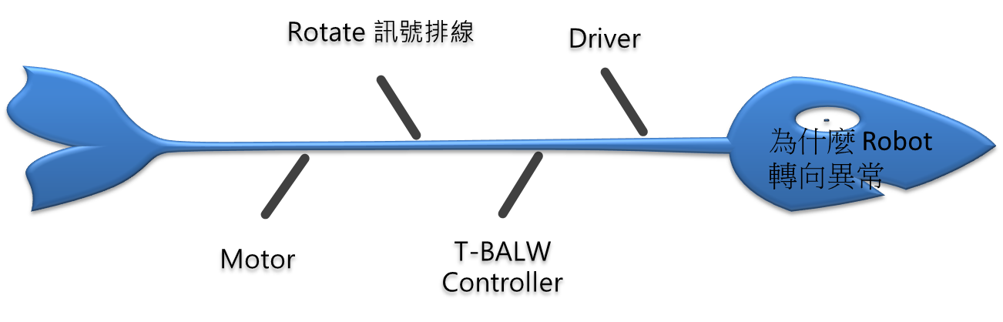
Discipline 4.定義及驗證真因 (Identify the Root Cause)
(Identify all potential causes which could explain why the problem occurred)
4.1 Non-conformance root cause (defect nature / technical root cause):
c) 真因驗證 (Root Cause Verification)
Driver 異常 ─ 量 driver run/stop 電壓正常……非真因
T-BAWL controller 異常 ─ check T-BAWL controller 操作正常……非真因
Rotate motor 異常 ─ check Rotate motor 正轉/逆轉 & encoder 步數動作正常……非真因
x
x
x

Slide 16
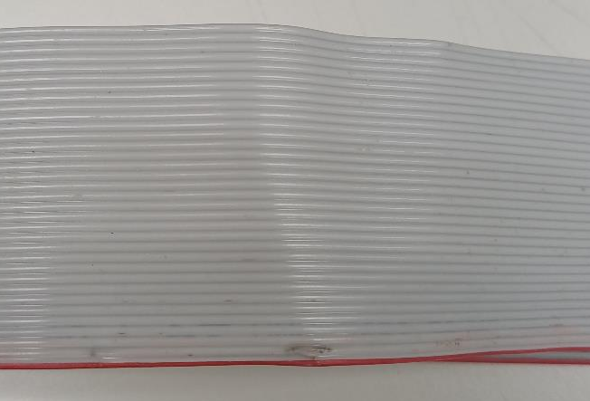
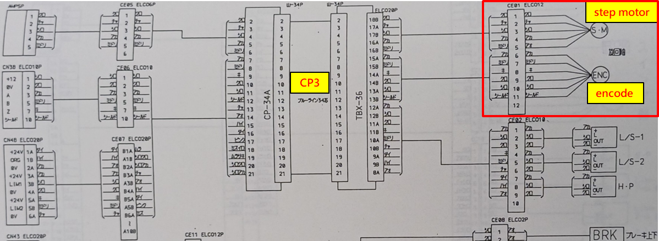
Discipline 4.定義及驗證真因 (Identify the Root Cause)
(Identify all potential causes which could explain why the problem occurred)
4.1 Non-conformance root cause (defect nature / technical root cause):
c) 真因驗證 (Root Cause Verification)
Rotate 訊號排線 ─ 檢查發現 Robot CP3 排線第2條線有 arcing 破損，量測其電阻值OL
外觀破損、電阻值異常
CP3 排線與 Robot 旋轉軸的 step motor、encode 相關

Slide 17
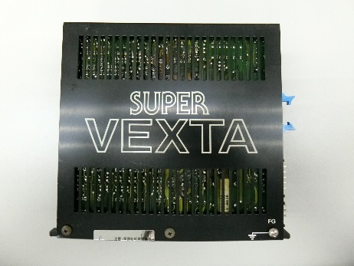
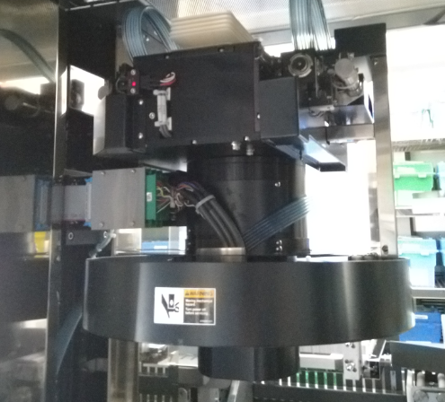
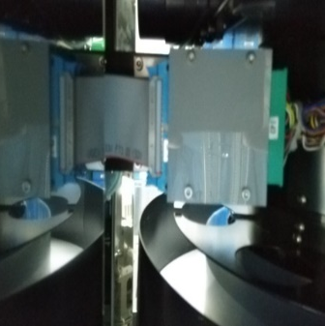
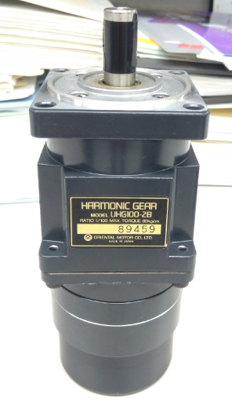
Discipline 4.定義及驗證真因 (Identify the Root Cause)
(Identify all potential causes which could explain why the problem occurred)
Robot rotate 由 5-phase driver 控制，訊號經過 CP3 排線傳送至 Rotate step motor
CP1~CP3 排線
Robot rotate driver
Rotate motor
若發生訊號排線 arcing 瞬間斷電，motor encoder 參數將變為 0
Robot rotate 參數：順時針增加，逆時針減少，若參數變為 0 後繼續動作 → 必定往順時針轉

Slide 18
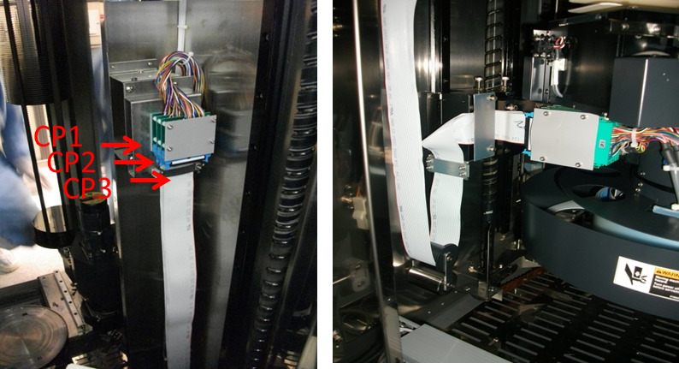
Discipline 4.定義及驗證真因 (Identify the Root Cause)
(Identify all potential causes which could explain why the problem occurred)
4.1 Non-conformance root cause (defect nature / technical root cause):
c) 真因驗證 (Root Cause Verification)
Replace Robot CP3 排線 → test load/unload wafer 4 cycle transfer ok，test run C05 recipe ok

Slide 19
Discipline 4.定義及驗證真因 (Identify the Root Cause)
(Identify all potential causes which could explain why the problem occurred)
4.1 Non-conformance root cause (defect nature / technical root cause):
d) 5-Why analysis
為什麼 F45 unload wafer 會破片?
因為 Robot carrier hand 撞擊 Cassette 內 wafer
為什麼 Robot carrier hand 撞擊到 Cassette 內 wafer?
因為 load/unload Cassette 時 Stage 在 backward 位置與 Robot 間距大, Rotate 空間大
load/unload wafer 時 Stage 在 forward 位置與 Robot 間距小, Rotate 空間小
carrier hand 會撞到 Cassette
為什麼 unload wafer 時 Carrier hand 會轉向 Cassette?
Robot unload Boat wafer 正常應逆時針旋轉,rotate 發生異常變順時針旋轉
為什麼 Robot rotate 會轉向異常?
因為控制 rotate motor 的訊號異常
為什麼控制 rotate motor 的訊號會發生異常?
因為 rotate motor 訊號排線(CP3) arcing 破損
b) Conclusion :
Robot rotate motor 訊號排線(CP3) arcing 瞬間斷電後繼續動作,導致 Robot rotate 變順時針旋轉，轉向異常造成 carrier hand 撞擊 Cassette 內 wafer

Slide 20
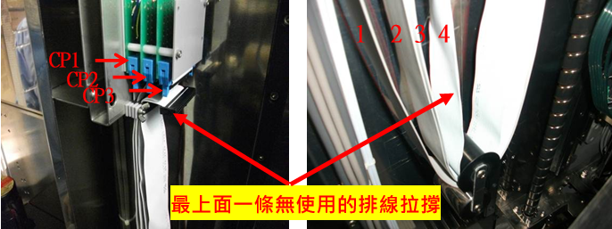
Discipline 5.擬定及驗證永久改善對策Choose and verify permanent corrective action (列出各項執行之對策並檢核其對策有效性)
5.1 What was the chosen corrective action to correct the root cause? (Add photo or diagram where applicable.)
F45 replace Robot CP3 排線
F45 CP3 排線上次更換日期 2021/3/10 lifetime 約 4年6個月
平行展開更換所有爐管機台 CP3 排線
將 CP3 排線上方第4條無使用的空排線拉撐，使其承受吊錘滾輪的作用力,
避免吊錘滾輪作用力壓在 CP3 排線上
Parts自動提醒設定4年後檢查CP3排線確認

Slide 21
Discipline 5.擬定及驗證永久改善對策Choose and verify permanent corrective action (列出各項執行之對策並檢核其對策有效性)
5.2 Verification of actions effectiveness
F45 2025/10/2 replace Robot CP3 排線至今 Robot transfer 均正常

Slide 22
Discipline 6.實施認永久改善對策Corrective Actions Implementation
6.1 For non-conformance root cause (defect nature / technical root cause):
Nbr. | Actions | Who | When | Remarks / Evidence (Document/Spec/Chart #)
F45 | Replace Robot CP3 排線 | 黃建華 | 2025/10/02 | Check transfer & test run robot rotate ok
6.2 For non-detection / escape root cause
Nbr. | Actions | Who | When | Remarks / Evidence (Document/Spec/Chart #)

Slide 23
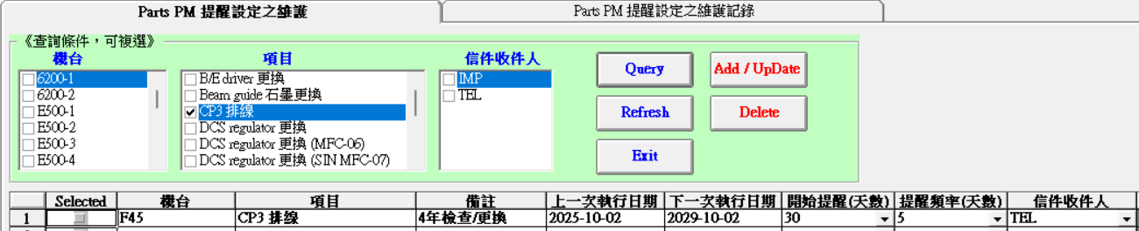
Discipline 7.避免再發Prevent Recurrence (Modify System / Document)
7.1 Systemic Actions:
Factor | Actions | Who | When | Remarks / Evidence (Document/Spec/Chart #)
Practices/ Training | Replace Robot CP3 排線 | 黃建華 | 2025/10/02 | Robot transfer & test run normal
Work Instruction
Specification
Control Plan | Parts自動提醒設定4年後檢查CP3排線確認 | 蔡孟哲 | 2025/11/30
* FMEA (must)
Error Proofing

Slide 24
Discipline 7.避免再發Prevent Recurrence (Modify System / Document)
7.2 Corrective Actions Fan-out: (水平展開):
Machine/ Process/ Product | Actions | Responsible | Due date
TEL Furnace | 所有爐管機台 replace Robot CP3 排線 | S220 | 2026/5/27
CP3 排線更換
機台 | 時間 | 機台 | 時間 | 機台 | 時間 |  | 已完成
LP-N1 | 2/6/2026 | LP-P1 | 3/24/2026 | LP-T1 | 4/15/2026 |  | 64 |  | 64
LP-N2 | 3/11/2026 | LP-P2 | 2/6/2026 | LP-T2 | 3/20/2026
LP-N3 | 3/6/2026 | LP-P3 | 3/16/2026 | LP-T3 | 4/13/2026
LP-N4 | 3/17/2026 | LP-P4 | 3/6/2026 | LP-T4 | 3/10/2026
LP-N5 | 2/10/2026 | LP-P6 | 2/10/2026 | LP-T5 | 2/10/2026 |  | 100.00%
LP-N6 | 3/31/2026 | LP-P7 | 4/14/2026 | LP-T6 | 3/18/2026
LP-N7 | 2/9/2026 |  |  | LP-T8 | 3/6/2026
 |  |  |  | LP-T9 | 4/14/2026
機台 | 時間 | 機台 | 時間 | 機台 | 時間 | 機台 | 時間 | 機台 | 時間
F01 | 4/2/2026 | F11 | 2/9/2026 | F21 | 5/18/2026 | F32 | 3/17/2026 | F42 | 5/27/2026
F02 | 5/19/2026 | F12 | 5/13/2026 | F22 | 2/10/2026 | F33 | 5/14/2026 | F44 | 5/15/2026
F03 | 4/28/2025 | F13 | 5/15/2026 | F23 | 5/18/2026 | F34 | 5/15/2026 | F45 | 4/10/2026
F04 | 3/12/2026 | F14 | 5/19/2026 | F24 | 5/25/2026 | F35 | 3/12/2026
F05 | 2/5/2026 | F15 | 5/21/2026 | F25 | 3/27/2026 | F36 | 5/15/2026
F06 | 2/5/2026 | F16 | 2/7/2026 | F26 | 4/13/2026 | F37 | 4/22/2026
F07 | 10/7/2025 | F17 | 5/21/2026 | F27 | 5/13/2026 | F38 | 2/6/2026
F08 | 2/8/2026 | F18 | 5/22/2026 | F28 | 4/20/2026 | F39 | 4/29/2026
F09 | 5/20/2026 | F19 | 4/15/2026 | F29 | 5/11/2026 | F40 | 5/20/2026
F10 | 5/26/2026 | F20 | 2/9/2026 | F30 | 5/14/2026 | F41 | 4/10/2026

Slide 25
Discipline 8. Congratulate the Team
Thanks for every member helped in this case.
Reviewed and Approved by:
Name | 2. Position | 3. Date
S220 邱尊護 | SECTION MANAGER | 2026/5/27
S200 李明驥 | DEPARTMENT MANAGER | 2026/5/27

